Slide 1
Database Application and It’s Security
PRESENTATION
ON

Slide 2





Presented By:
Team Member – 01
Name: Tunazzinur Rahman Kabbo
ID: 19202103268
Team Member – 04
Name: Rubaiatul Jannat
ID: 19202103249
Team Member – 02
Name: MD. Zobayer Hasan Nayem
ID: 19202103274
Team Member – 05
Name: MD. Abu Essa
ID: 19202103265
Team Member – 03
Name: Hamim Reza
ID: 19202103269

Slide 3


Presented To:
Badhan Chandra Das
Lecturer
Department of Computer Science & Engineering
Email: badhan_das@bubt.edu.bd

Slide 4
What is database
A database is an organized collection of structured information, or data, typically stored electronically in a computer system. A database is usually controlled by a database management system (DBMS). Together, the data and the DBMS, along with the applications that are associated with them, are referred to as a database system, often shortened to just database.
Data within the most common types of databases in operation today is typically modeled in rows and columns in a series of tables to make processing and data querying efficient. The data can then be easily accessed, managed, modified, updated, controlled, and organized. Most databases use structured query language (SQL) for writing and querying data.

Slide 5
Database applications

Slide 6
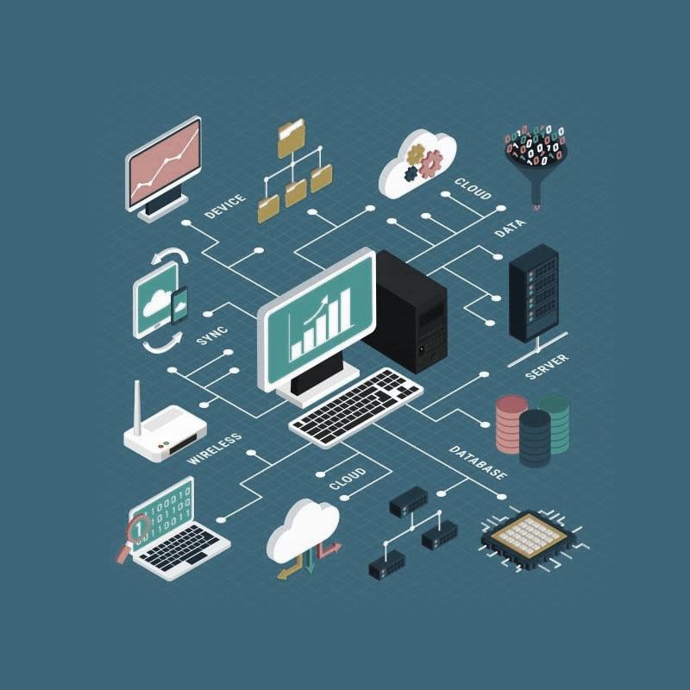
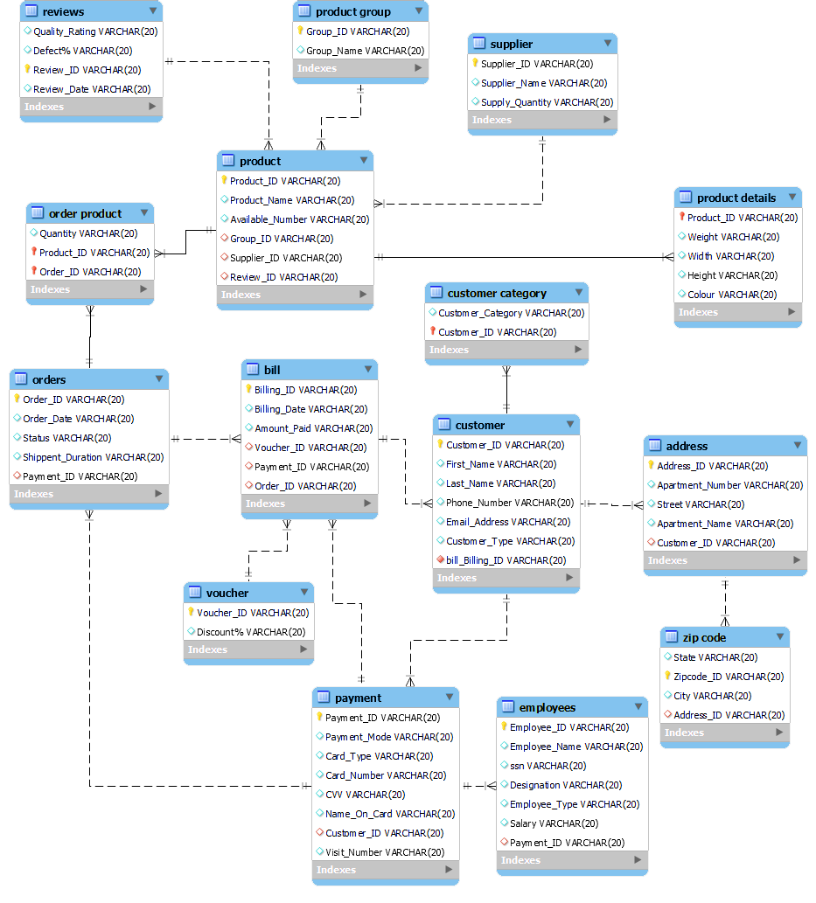
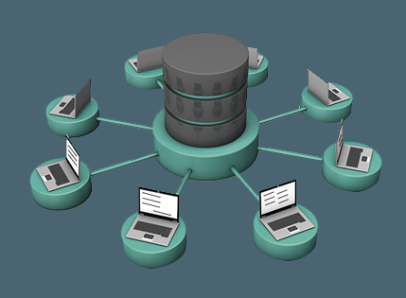
What are database Applications
A database application is a computer program whose primary purpose is retrieving information from a computerized database. From here, information can be inserted, modified or deleted which is subsequently conveyed back into the database.
In so many fields, we use a database management system.
Let’s see some of the applications where database management system uses.

Slide 7
Railway Reservation System − The railway reservation system database plays a very important role by keeping record of ticket booking, train’s departure time and arrival status and also gives information regarding train late to people through the database.
Library Management System − Now-a-days it’s become easy in the Library to track each book and maintain it because of the database. This happens because there are thousands of books in the library. It is very difficult to keep a record of all books in a copy or register. Now DBMS used to maintain all the information related to book issue dates, name of the book, author and availability of the book.
Banking − Banking is one of the main applications of databases. We all know there will be a thousand transactions through banks daily and we are doing this without going to the bank. This is all possible just because of DBMS that manages all the bank transactions.
Universities and colleges − Now-a-days examinations are done online. So, the universities and colleges are maintaining DBMS to store Student’s registrations details, results, courses and grade all the information in the database. For example, telecommunications. Without DBMS there is no telecommunication company. DBMS is most useful to these companies to store the call details and monthly postpaid bills.

Slide 8
Credit card transactions − The purchase of items and transactions of credit cards are made possible only by DBMS. A credit card holder has to know the importance of their information that all are secured through DBMS.
Social Media Sites − By filling the required details we are able to access social media platforms. Many users sign up daily on social websites such as Facebook, Pinterest and Instagram. All the information related to the users are stored and maintained with the help of DBMS.
Finance − Now-a-days there are lots of things to do with finance like storing sales, holding information and finance statement management etc. these all can be done with database systems.
Military − In military areas the DBMS is playing a vital role. Military keeps records of soldiers and it has so many files that should be kept secure and safe. DBMS provides a high security to military information.
Online Shopping − Now-a-days we all do Online shopping without wasting the time by going shopping with the help of DBMS. The products are added and sold only with the help of DBMS like Purchase information, invoice bills and payment.

Slide 9
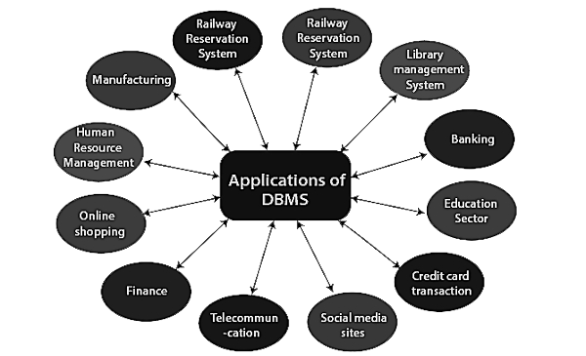
Human Resource Management − The management keeps records of each employee’s salary, tax and work through DBMS.
Manufacturing − Manufacturing companies make products and sell them on a daily basis. To keep records of all those details DBMS is used.
Airline Reservation system − Just like the railway
reservation system, airlines also need DBMS to keep
records of flights arrival, departure and delay status.
There are more sectors in daily life where DBMS is being
used. To introduce all of them isn’t possible in
this presentation.

Slide 10
Database security

Slide 11



database security
Database security concerns the use of a broad range of information security controls to protect databases (potentially including the data, the database applications or stored functions, the database systems, the database servers and the associated network links) against compromises of their confidentiality, integrity and availability. It involves various types or categories of controls, such as technical, procedural/administrative and physical.
Security risks to database systems include, for example:

Slide 12
Unauthorized or unintended activity or misuse by authorized database users, database administrators, or network/systems managers, or by unauthorized users or hackers (e.g. inappropriate access to sensitive data, metadata or functions within databases, or inappropriate changes to the database programs, structures or security configurations);
Malware infections causing incidents such as unauthorized access, leakage or disclosure of personal or proprietary data, deletion of or damage to the data or programs, interruption or denial of authorized access to the database, attacks on other systems and the unanticipated failure of database services;
Overloads, performance constraints and capacity issues resulting in the inability of authorized users to use databases as intended;
Physical damage to database servers caused by computer room fires or floods, overheating, lightning, accidental liquid spills, static discharge, electronic breakdowns/equipment failures and obsolescence;
Design flaws and programming bugs in databases and the associated programs and systems, creating various security vulnerabilities (e.g. unauthorized privilege escalation), data loss/corruption, performance degradation etc.;
Data corruption and/or loss caused by the entry of invalid data or commands, mistakes in database or system administration processes, sabotage/criminal damage etc.

Slide 13
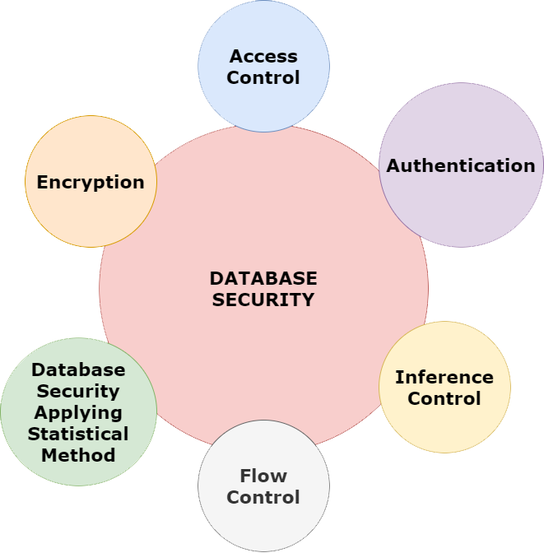
Many layers and types of information security control are appropriate to databases, including:
Access control
Authentication
Inference control
Flow control
Database Security applying Statistical Method
Encryption

Slide 14
Access Control - The security mechanism of DBMS must include some provisions for restricting access to the data base by unauthorized users. Access control is done by creating user accounts and to control login process by the DBMS. So, that database access of sensitive data is possible only to those people (database users) who are allowed to access such data and to restrict access to unauthorized persons. The database system must also keep the track of all operations performed by certain user throughout the entire login time.
Authentication - Authentication is the process of confirmation that whether the user log in only according to the rights provided to him to perform the activities of data base. A particular user can login only up to his privilege but he can’t access the other sensitive data. The privilege of accessing sensitive data is restricted by using Authentication. By using these authentication tools for biometrics such as retina and figure prints can prevent the data base from unauthorized/malicious users.
Inference Control - This method is known as the countermeasures to statistical database security problem. It is used to prevent the user from completing any inference channel. This method protect the sensitive information from indirect disclosure. Inferences are of two types, identity disclosure or attribute disclosure.
Flow Control - This prevents information from flowing in a way that it reaches unauthorized users. Channels are the pathways for information to flow implicitly in ways that violate the privacy policy of a company are called covert channels.

Slide 15
Database Security applying Statistical Method - Statistical database security focuses on the protection of confidential individual values stored in and used for statistical purposes and used to retrieve the summaries of values based on categories. They do not permit to retrieve the individual information. This allows to access the database to get statistical information about the number of employees in the company but not to access the detailed confidential/personal information about specific individual employee.
Encryption - This method is mainly used to protect sensitive data (such as credit card numbers, OTP numbers) and other sensitive numbers. The data is encoded using some encoding algorithms. An unauthorized user who tries to access this encoded data will face difficulty in decoding it, but authorized users are given decoding keys to decode data.

Slide 16
In addition to implementing layered security controls across the entire network environment, database security requires to establish the correct controls and policies for access to the database itself. These include:
Administrative controls to govern installation, change, and configuration management for the database.
Preventative controls to govern access, encryption, tokenization, and masking.
Detective controls to monitor database activity monitoring and data loss prevention tools. These solutions make it possible to identify and alert on anomalous or suspicious activities.

Slide 17
Bibliography:
Wikipedia – www.wikipedia.com
Oracle – www.oracle.com
IBM – www.ibm.com
Techopedia – www.techopedia.com
Github – www.github.com
Geeks For Geeks - www.geeksforgeeks.org

Slide 18
Thank You

